Slide 1
UNIT : 4.2
COMPUTER SYSTEMS & SOFTWARE

Slide 2
Difference between HDD & SDD
Hard Disk Drive | Solid State Drive
Overtime, and with larger files stored on an HDD, fragmentation can occur | Fragmentation doesn’t occur on an SSD
An HDD is more commonly available in lots of different capacities. | An SSD is available in limited storage capacities and it isn’t available everywhere.
An HDD is noisy. Some are less noisy, some are more noisy, but they are definitely noisy. | An SSD is quiet as a mouse because it has no moving parts.
Compared to SSDs, an HDD is slower at reading and writing data. | An SSD is much faster at reading and writing data than an HDD. These drives are often preferred by gamers for a better gaming experience and that’s why gaming laptops and PCs generally cost more
Although energgy consumption by an HDD is not huge, we’re comparing it to that of an SSD and it’s higher. | An SSD consumes significantly less energy than an HDD and it won’t heat up much. An HDD is likely to heat up much more than an SSD of equal capacity

Slide 3
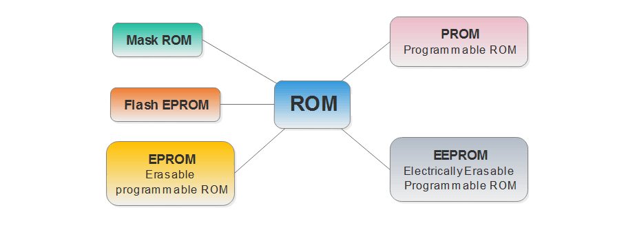
DIFFERENT TYPES OF ROM
ROM is differentiated on the basis of methods used to write data on ROM chips and the number of times they can be written. It can be classified into following types:-
Mask Read-Only Memory (MROM)
Programmable Read-Only Memory (PROM)
Erasable Programmable Read-Only Memory (EPROM)
Electrically Erasable Programmable Read-Only Memory (EEPROM)
Flash Read-Only Memory (Flash ROM)

Slide 4
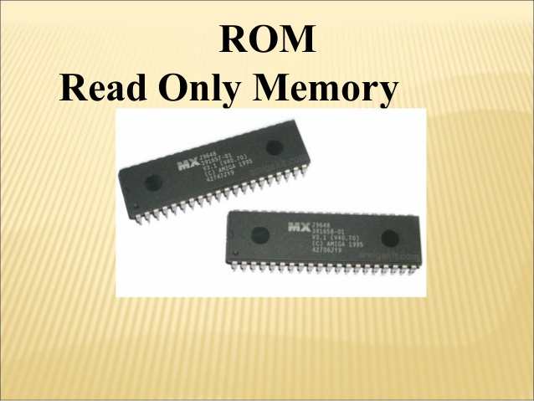
Mask Read-Only Memory (MROM)
MROM stands for Mask Read Only Memory. It is a memory chip that is manufactured with its contents. These are inexpensive and are the very first ROMs which were hard wired devices that contain a pre-programmed set of data or instructions.
These chips contain a software mask that is burned onto the chip during design phase of the semiconductor manufacturing process.
The specification of the ROM is taken by the manufacturer from its customer in tabular form and in a particular format. The manufacturer then makes the corresponding mask for the paths to produce the desired output.

Slide 5
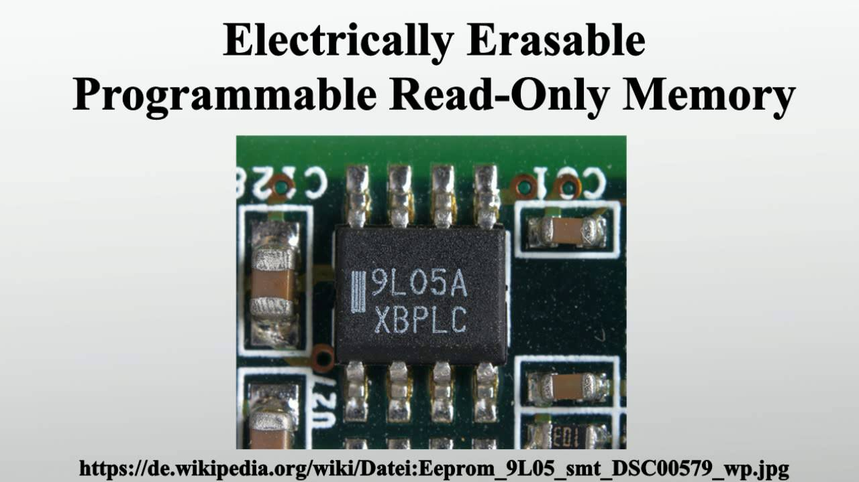
Programmable Read Only Memory (PROM)
Programmable Read Only Memory (PROM)
PROM stands for Programmable Read Only Memory. PROM is manufactured as a blank memory. And as its name suggests Programmable, it is programmed after manufacturing. The user buys a blank memory and enters the desired contents using a PROM program.
The process of programming a PROM is called burning the PROM. There are tiny fuses in a PROM chip which are burnt open during programming. The data can be programmed only once and cannot be altered. So it is called one- time programming device.

Slide 6
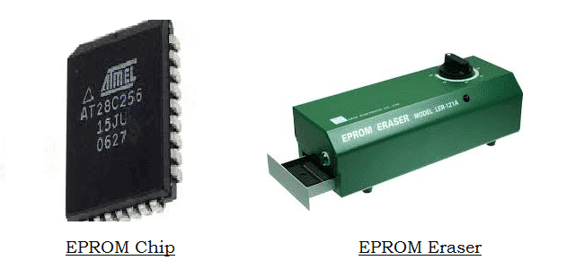
Erasable Programmable Read Only Memory (EPROM)
EPROM stands for Erasable Programmable Read-Only Memory. It is a non volatile memory i.e. it can retain data even if the power supply is cut off. The basic limitation being encountered in PROM is that once it is programmed, it cannot be changed or altered. This limitation has been overcame by EPROM.
EPROM can be erased by exposing it to ultra violet light for a particular length of time using an EPROM eraser. After exposing, the chip returns to its initial state and can be reprogrammed.
This procedure can be carried out many times but repeated erasing and rewriting can eventually render the chip useless. Once written, data can be retained for about 10 years.

Slide 7
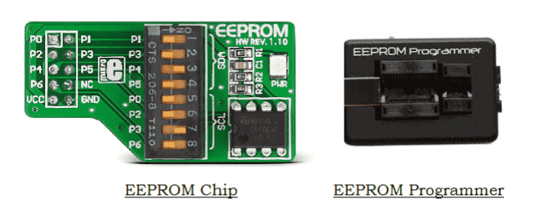
Electrically Erasable Programmable Read Only Memory (EEPROM)
EEPROM is the short form for Electrically Erasable Programmable Read Only Memory. It is similar to EPROM and thus developed to overcome the drawbacks of EPROMs. It is erased and programmed electrically i.e. it uses electrical signals instead of ultra violet rays.
The erasing and programming of data takes 4 to 10 milliseconds. Any byte can be erased at a time instead of the entire chip. The chip can be erased and re programmed for around ten thousand times, though the process is flexible but slow.

Slide 8
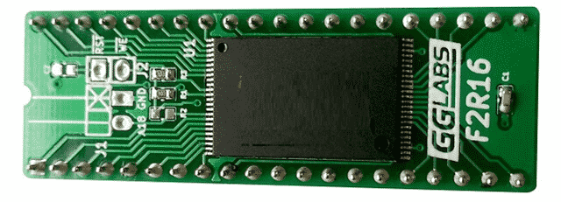
Flash Read Only Memory (Flash ROM)
It is a universal flash programming non volatile utility, used in computer as a storage medium. It can be electrically erased and reprogrammed. In this, memory blocks of data (512 bytes) can be deleted and written at a particular time.

Slide 9
THANK YOU!

